Slide 1
Scaling Spatial Reasoning for VLMs at Inference Time
Haoming Wang, Qiyao Xue and Wei Gao
University of Pittsburgh

Slide 2
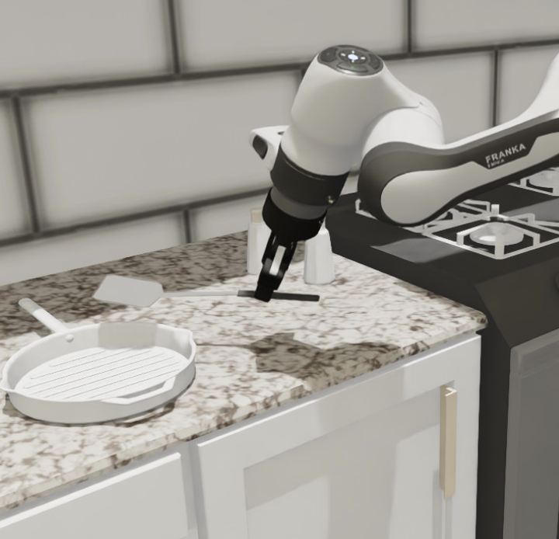
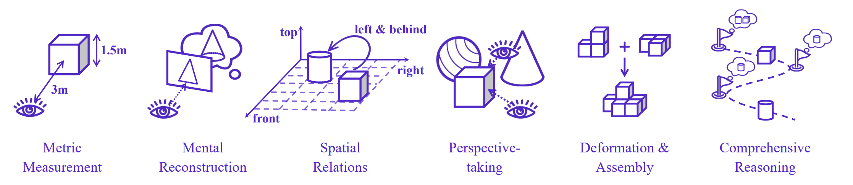
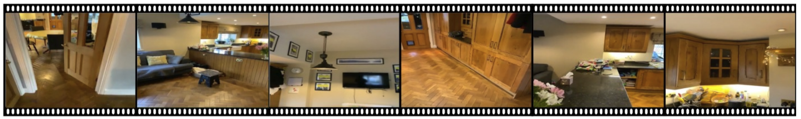
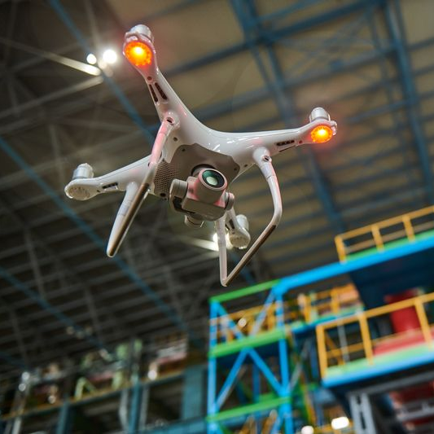
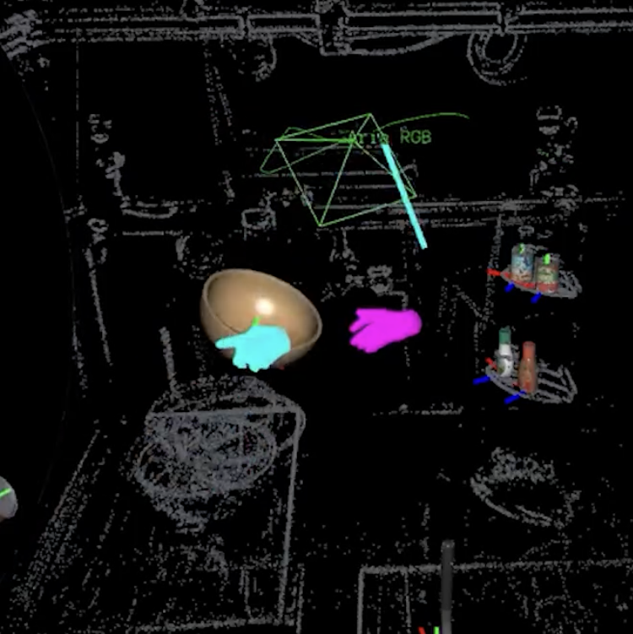
Fundamental Capabilities of Spatial Intelligence
Measurement
Mental reconstruction
Robotics Manipulator
Relative Relation
Perspective taking
Autonomous Drones
Egocentric Visual inputs
Mental rotation
Multi-step
Wearable AR
Basic Spatial Reasoning Capabilities
Spatial-aware Applications

Slide 3

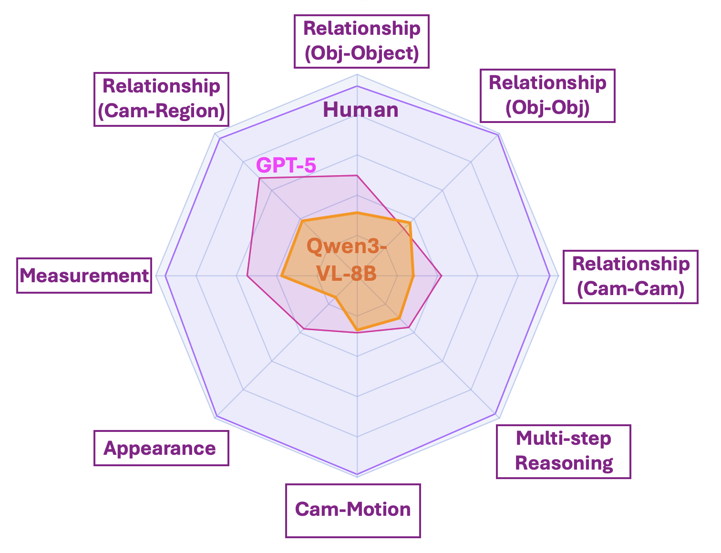
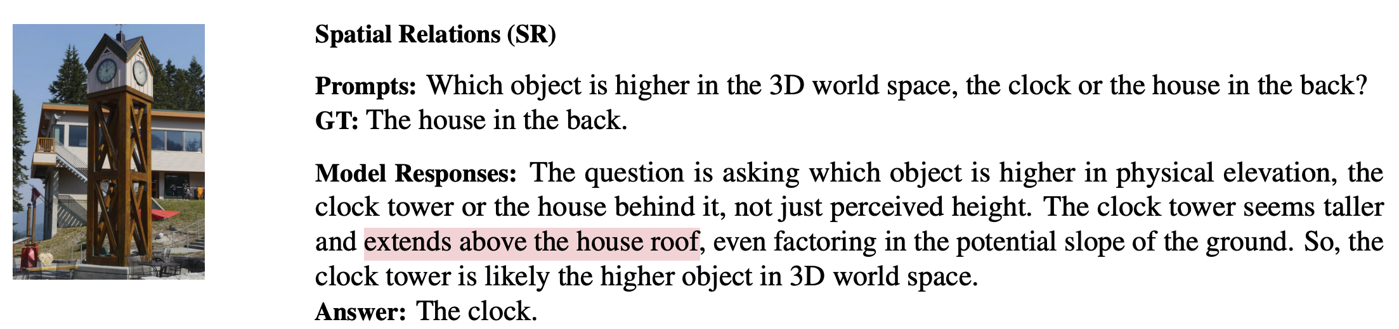

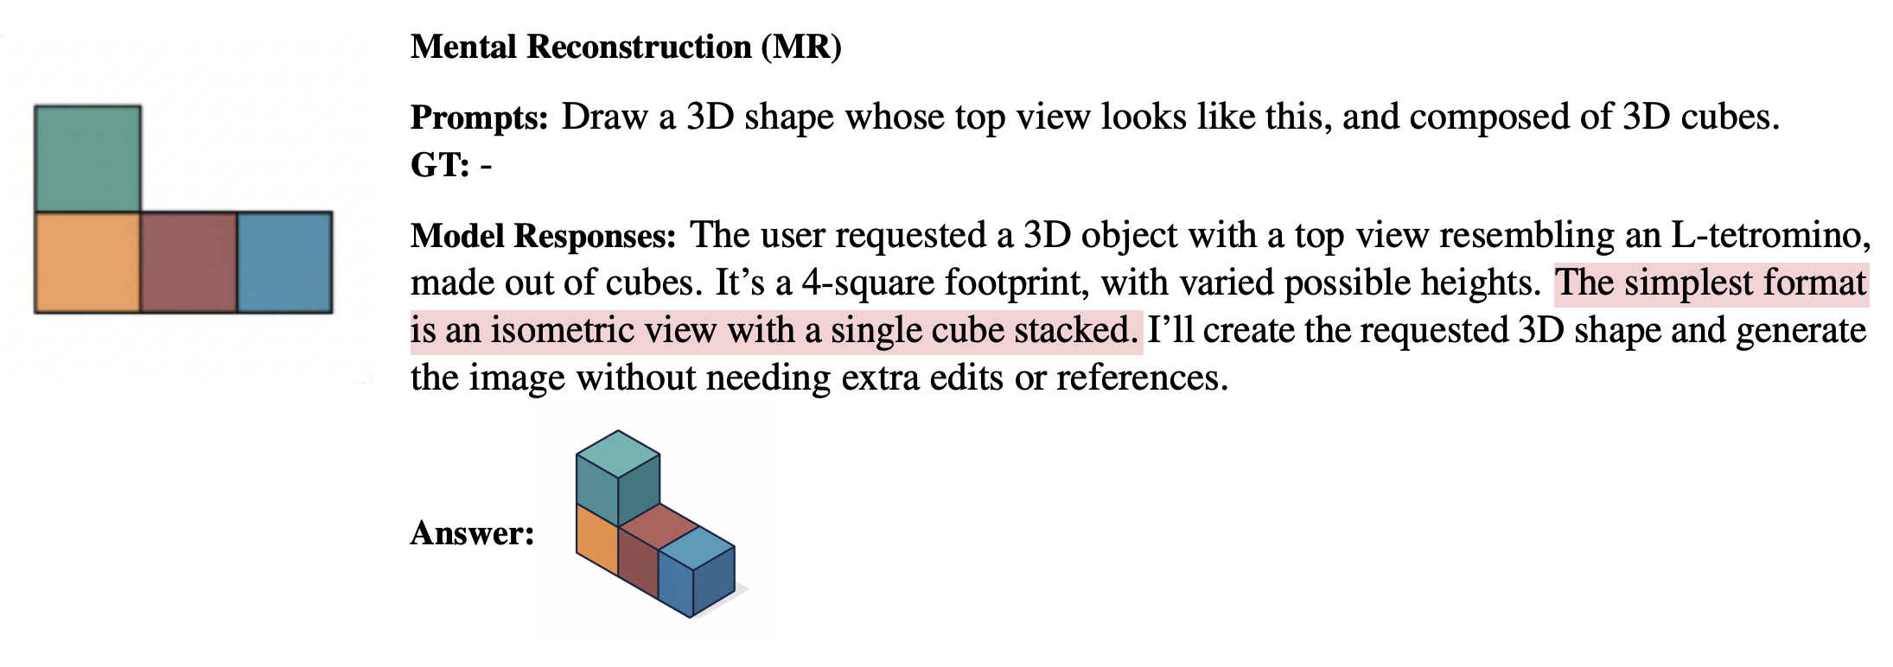
the performance gap between VLMs and humans
Reasoning based on 2d pixel space
Human VS Proprietary models
VS Open-sourced general models
Struggle in mental rotation
Has GPT-5 Achieved Spatial Intelligence? An Empirical Study
Notes:
Has GPT-5 Achieved Spatial Intelligence? An Empirical Study

Slide 4
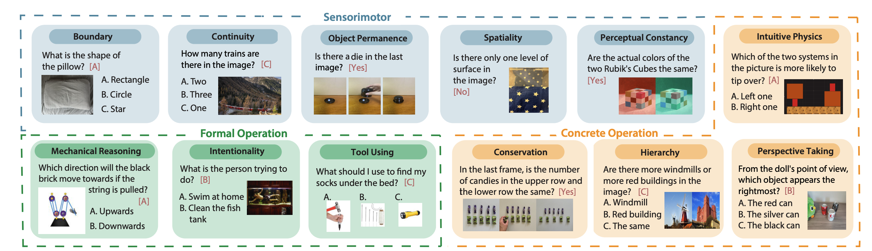
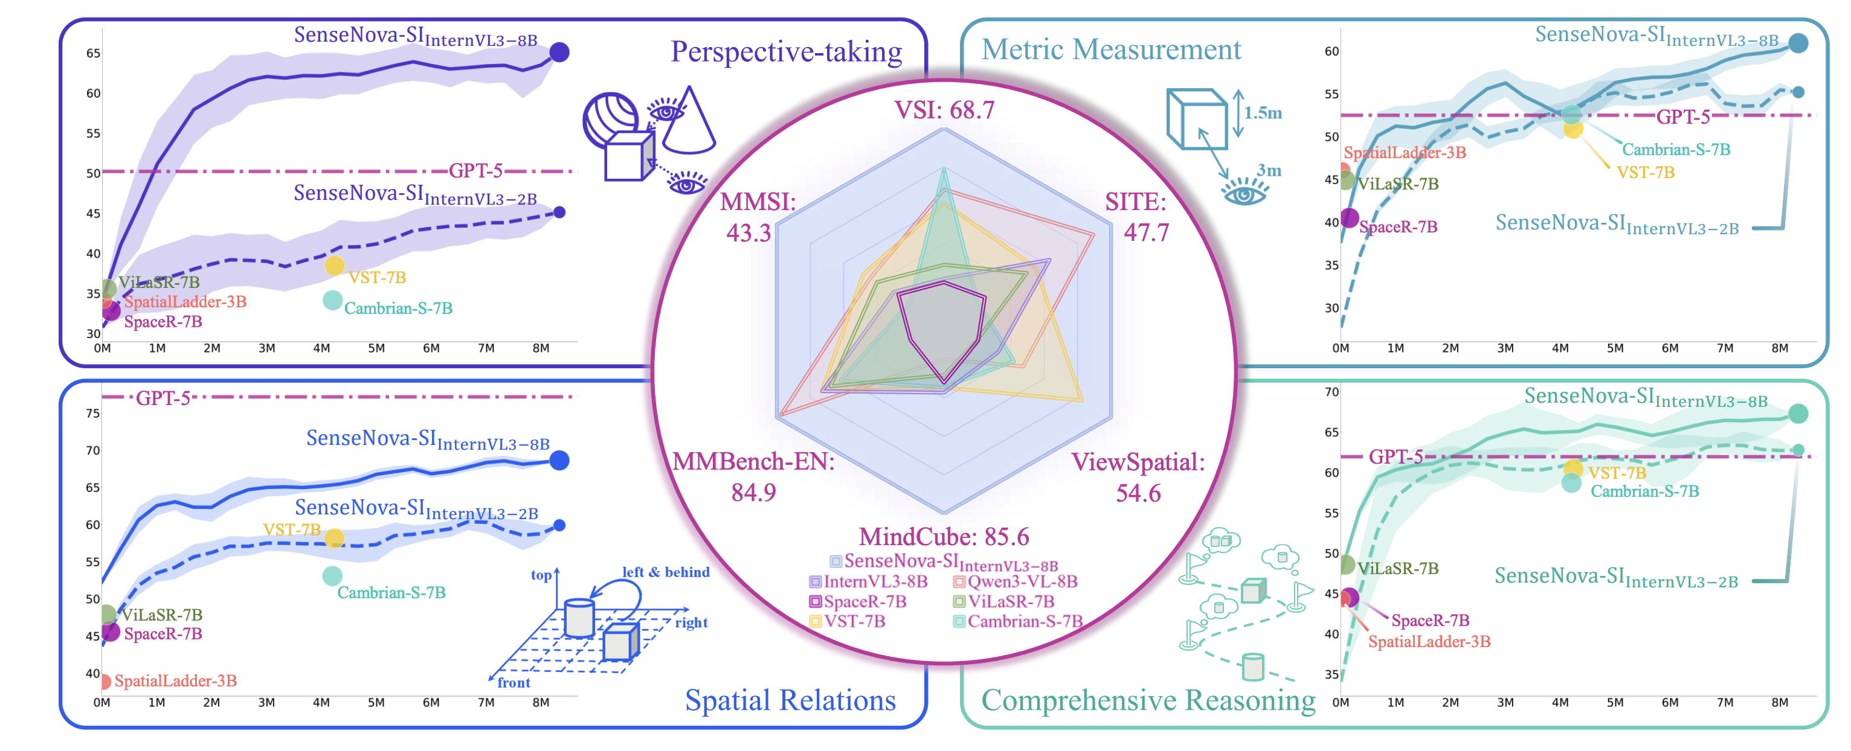
Can we solve spatial reasoning by further scaling training data
Spatial reasoning is not "emerging" at the same rate as other language or vision capabilities
Basic cognition
Spatial reasoning
79
78
95
51
36
25
Human
GPT5
InternVL3
Human
GPT5
InternVL3
Performance
Performance
Plateaued after 2M data samples
Data volume
Data volume
Measurement Task
Multi-step reasoning task
Notes:
Spatial reasoning is not "emerging" at the same rate as other language or vision capabilities; it appears to be a distinct capability that current architectures are struggling to learn from massive 2D data scaling alone.
Core Knowledge Deficits in Multi-Modal Language Models

Slide 5

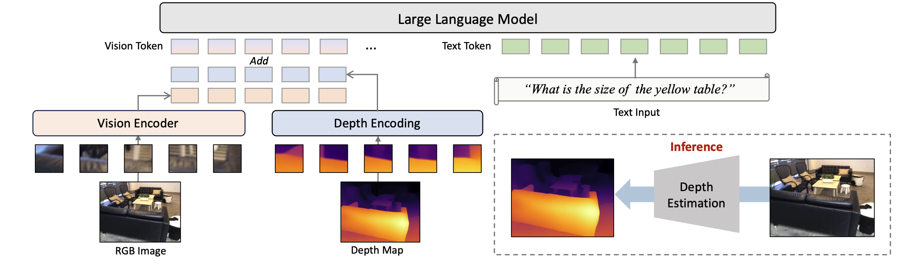

Injecting 3D data to input layer – limited improvement
Typical pipeline of adding new modality to VLM input layer
Finetuning LLM backbone
3D data Encoder
3D data
Limited improvement:
89
57
60
42
40
47
41
Human
Qwen3-VL-8B
InternVL3-8B
LLaVA-Video-72B
Spatial-MLLM
VST-7B-SFT
SpaceR-7B
General VLM
Fine-tuned with spatial data
Notes:
For example, if a question asks, "What object is typically found right next to the bed?", a text-only model can easily guess "nightstand" based on billions of pages of text data it has read. It doesn't need to look at the 3D room to get the answer right.
DO 3D LARGE LANGUAGE MODELS REALLY UNDERSTAND 3D SPATIAL RELATIONSHIPS?

Slide 6
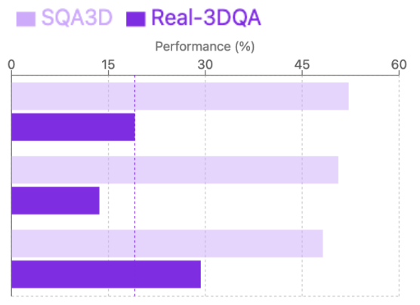
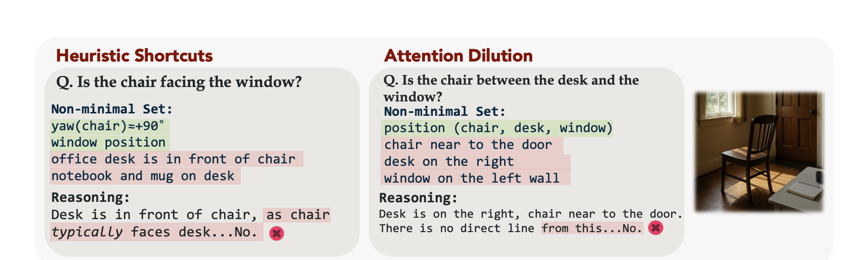
Injecting 3D data to input layer – limited improvement
Typical pipeline of adding new modality to VLM input layer
Finetuning LLM backbone
3D data Encoder
3D data
The model didn’t actually reason with 3d data
- Language shortcut
- Raw 3d data is too information-dense
performance plummeted after linguistic cues were removed
flooding the context with distracting geometric details and inducing hallucinations.
Notes:
For example, if a question asks, "What object is typically found right next to the bed?", a text-only model can easily guess "nightstand" based on billions of pages of text data it has read. It doesn't need to look at the 3D room to get the answer right.
DO 3D LARGE LANGUAGE MODELS REALLY UNDERSTAND 3D SPATIAL RELATIONSHIPS?
PURSUING MINIMAL SUFFICIENCY IN SPATIAL REASONING

Slide 7
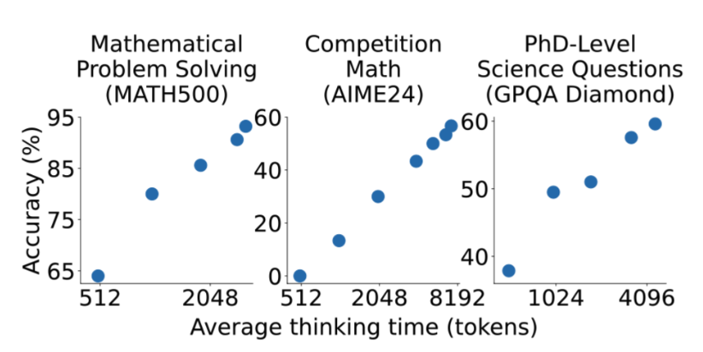
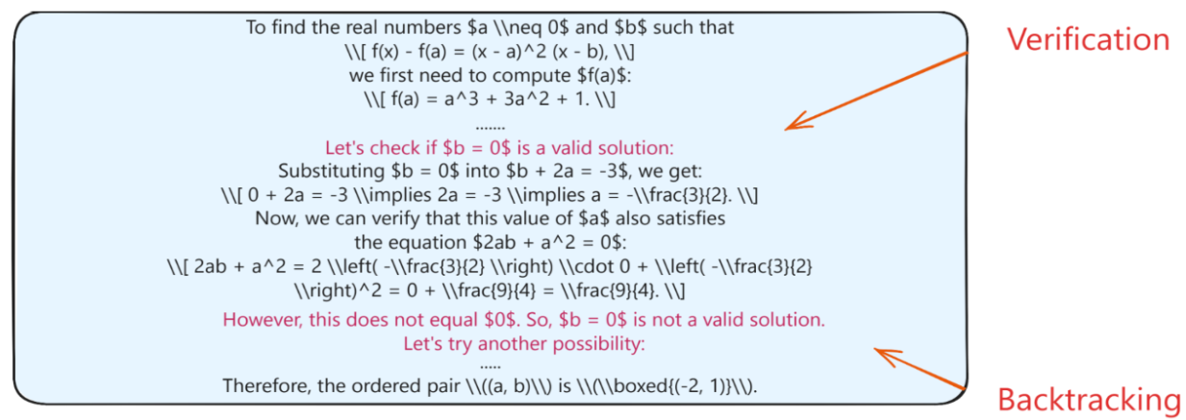
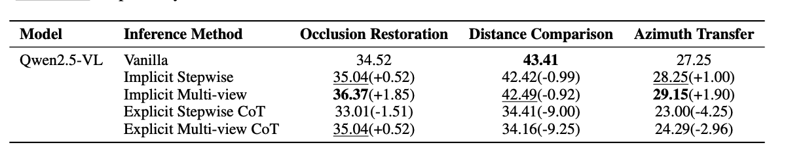
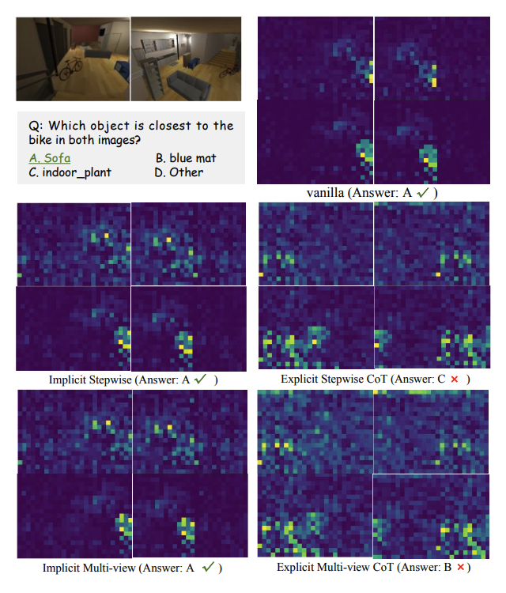
How to scale at inference time
Inference time scaling in text domain
Performance scales with thinking time
Ahah moment in reasoning
Thinking in text domain impair visual spatial reasoning
Notes:
explicit CoT prompting can actually impair spatial understanding
CoT caused the model's attention to diffuse (spread out) or focus too narrowly on the primary subject query, ignoring the critical contextual objects needed for spatial comparison.
https://lilianweng.github.io/posts/2025-05-01-thinking/

Slide 8
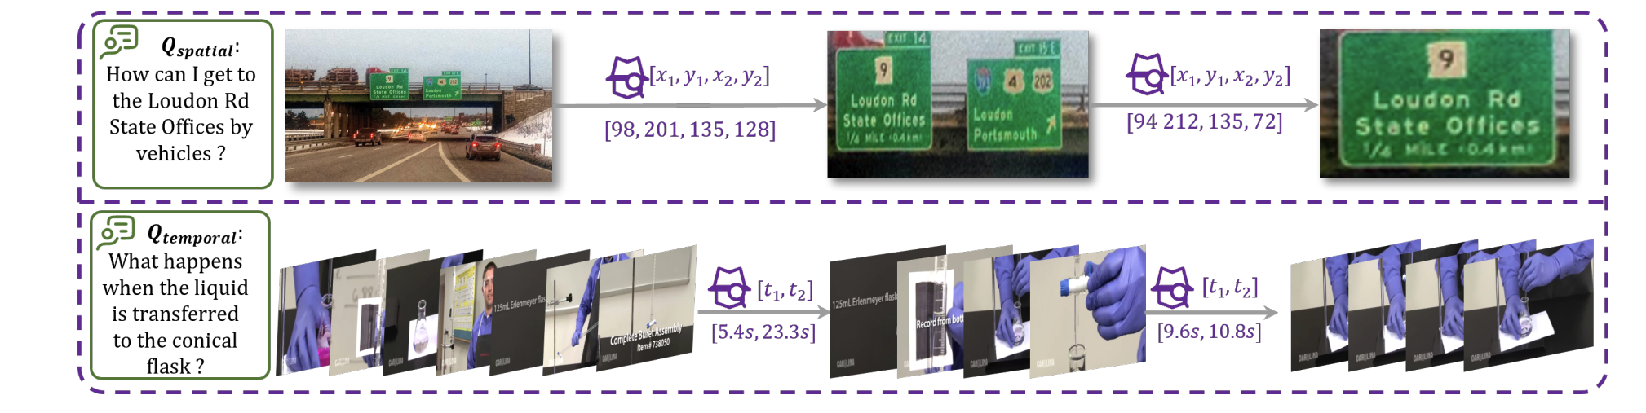
How to scale at inference time
Alternative method other than thinking in text
Think with image
Limitation:
- only guide the model to focus on task-relevant regions
- but does not enable it to extract spatial information

Slide 9

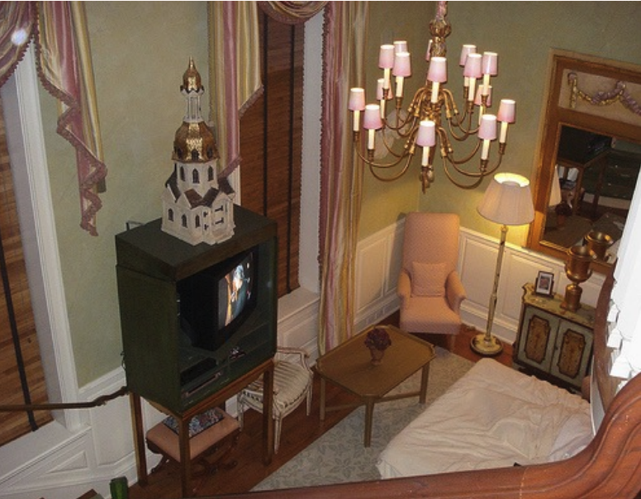






How to scale at inference time
Alternative method other than thinking in text
think with 3d aware tools as an agent
Rely on external tools
1 Think with image
Tool box
Extracted 3D information
Script for verification
Where is the table
Rely on VLM reasoning
think in a semantically rich latent space
…
<think>
Laten embeddings
Notes:
VideoChat-R1.5: Visual Test-Time Scaling to Reinforce Multimodal Reasoning by Iterative Perception

Slide 10
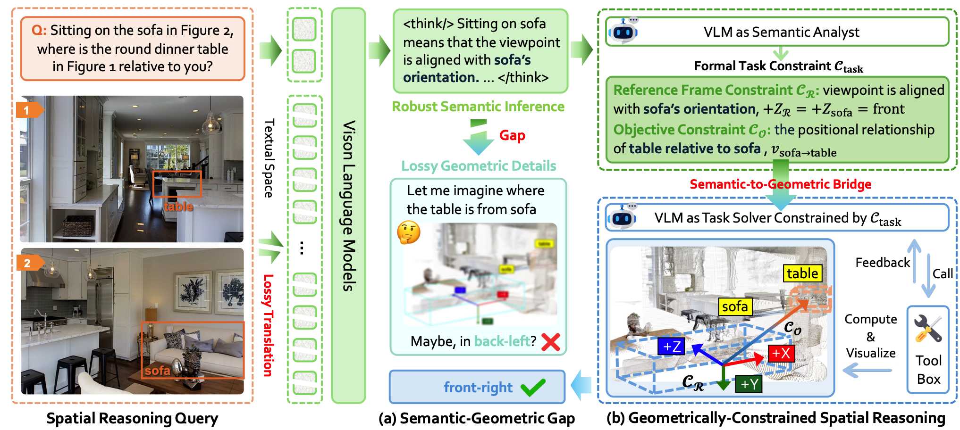
Existing work: Geometrically-Constrained Agent
Existing work: Geometrically-Constrained Agent
Provide a path of separating semantic reasoning from geometric computation

Slide 11
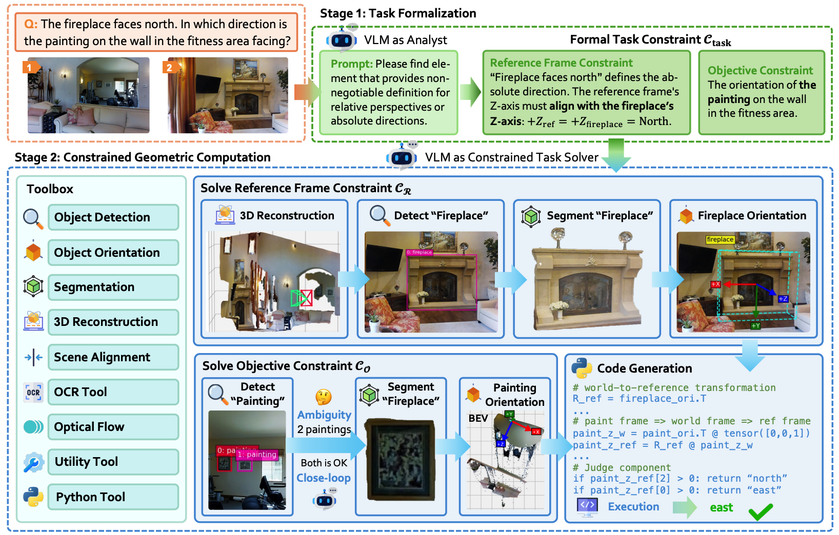
Existing work: Geometrically-Constrained Agent
Geometrically-Constrained Agent limitation
Decompose reasoning into coarse task formulation and constrained geometric computation handled by a VLM agent.
Lack of scalability to more complex downstream applications require spatial reasoning

Slide 12
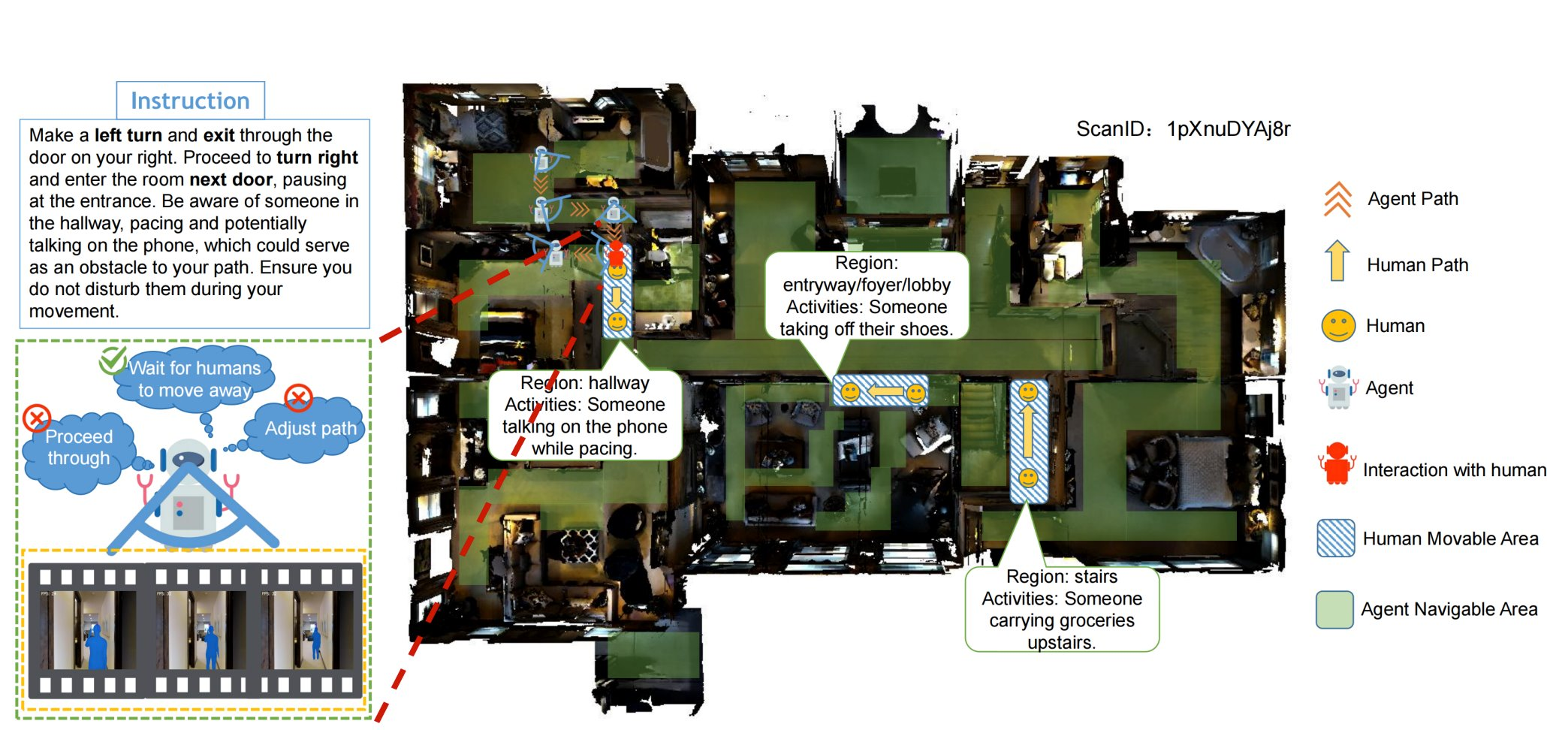
Potential idea: Agentic workflow on spatial reasoning task (navigation)
Design an agentic workflow with 3D tool use and navigation skills to improve VLM-based robot navigation under dynamic blocking conditions.

Slide 13
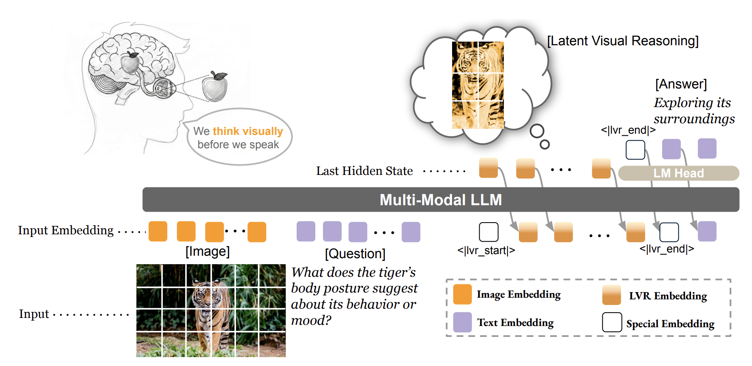
Existing work: Latent spatial reasoning
Motivation
A unified spatial representation should be embedded in continuous latent space, enabling 3D mental modeling for human-like spatial reasoning.
Most of current method focusing on 2D image perception rather than spatial reasoning with necessary 3D latent feature guidance.

Slide 14
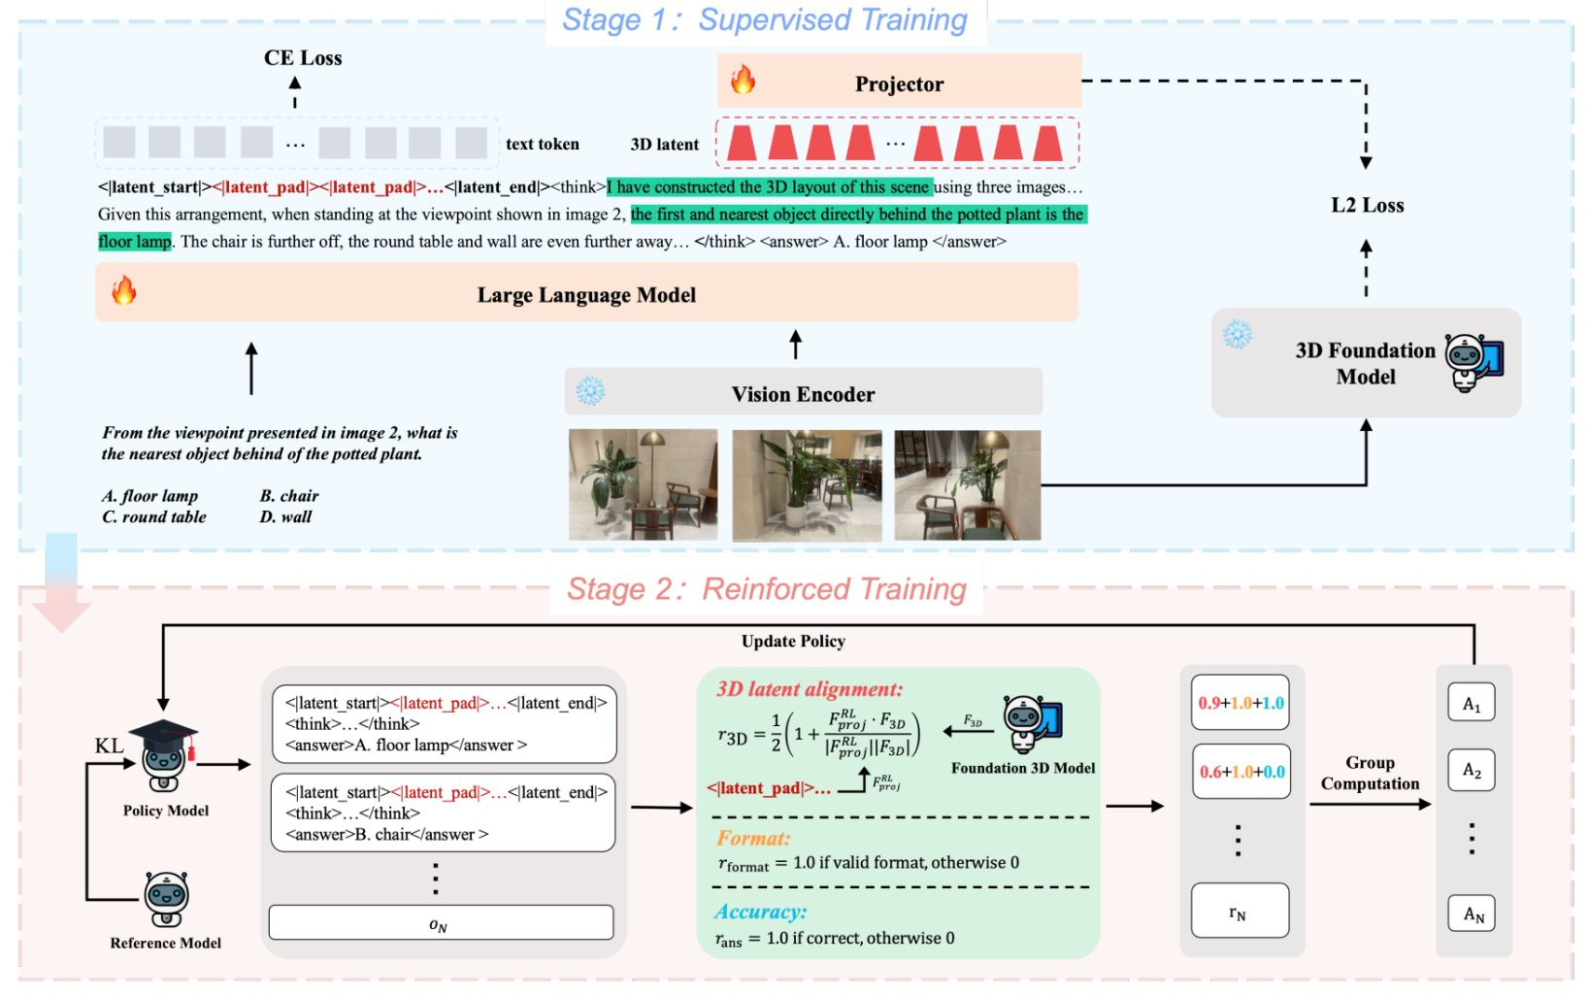
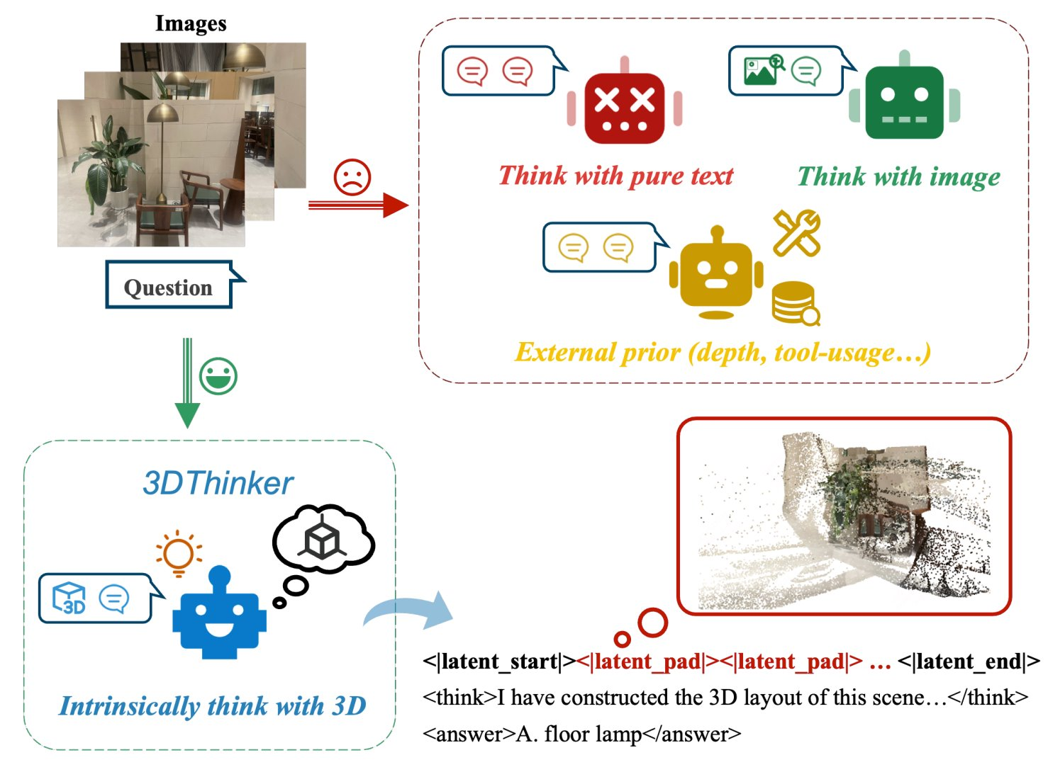
Existing work: Latent spatial reasoning
Latent spatial reasoning existing work & limitation
Latent spatial reasoning enables VLMs to reason in continuous vision–language latent space, guided by 3D models like VGGT and trained with SFT plus GRPO-based RLVR.
Only dense 3D features are used in latent reasoning, while fine-grained 2D spatial supervision at intermediate reasoning steps is missing.

Slide 15
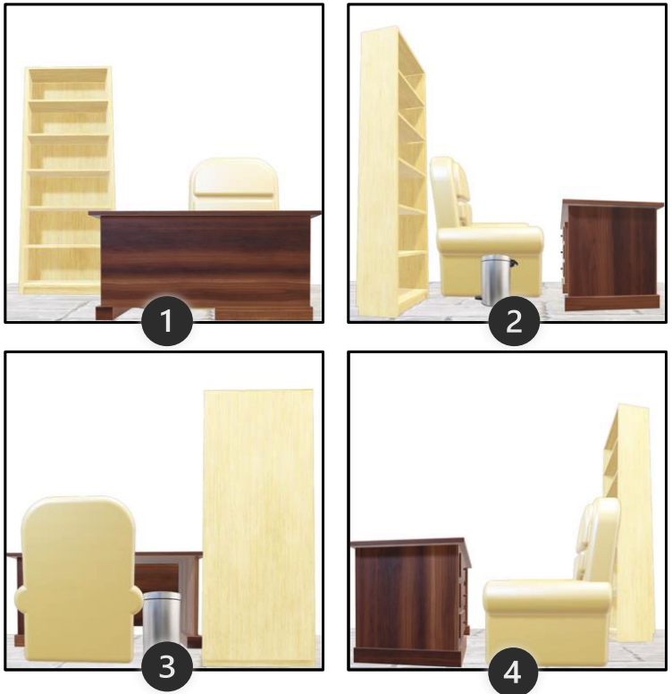
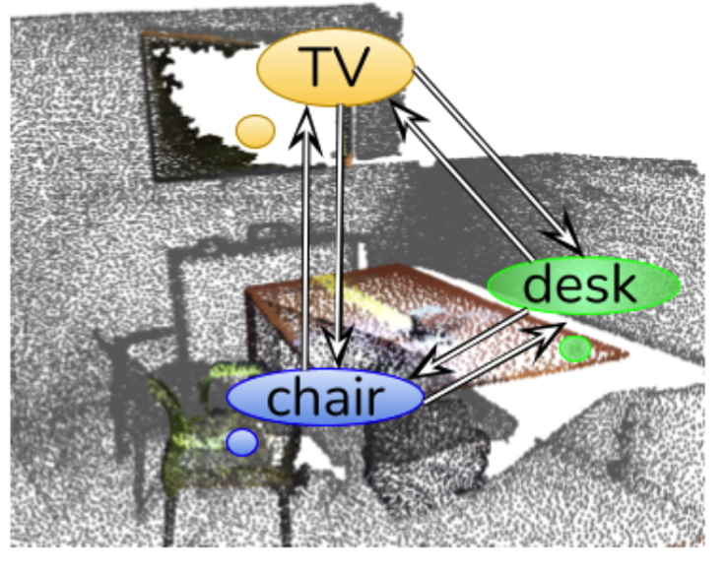


Potential idea: Latent spatial reasoning
Latent spatial reasoning potential idea
Extract step-level spatial cues to supervise reasoning during view shifts.
extract
+ camera pose
Input
Output
2D Vision encoder
Camera pose encoder
3D VGGT encoder
[Text token]
…
[2D latent token]
Embedding layer
…
VLM
…
…
…
Tokenization
…
[3D latent token]
<lts>
[2D latent token]
<lte>
[Query token]
[Image token]
…
[Text token]

